Slide 1

Disease Prediction System Using Machine Learning
An AI-powered diagnostic assistant for early detection and improved healthcare outcomes.

Slide 2

Introduction: Bridging the Healthcare Gap
Healthcare diagnosis often demands expert knowledge and timely medical consultation. Unfortunately, individuals frequently misinterpret early symptoms, leading to delayed diagnoses and potential complications.
Thanks to advancements in AI and machine learning, it's now possible to analyse symptom patterns and predict probable diseases with remarkable accuracy.
This project focuses on developing an AI-powered disease prediction system. It leverages symptom inputs to generate real-time, accurate predictions via an interactive web-based dashboard.

Slide 3

The Challenge: Timely and Accurate Diagnosis
Symptom Misinterpretation
Users struggle to interpret symptoms correctly, often delaying critical care.
Limited Doctor Availability
Immediate medical consultation isn't always possible when symptoms first appear.
Inaccurate Online Checkers
Traditional, rule-based online symptom checkers are often unreliable and lack depth.
Core Problem
We need a fast, reliable, machine-learning-based diagnostic assistant. The main challenge is accurately mapping 132+ symptoms to 40+ diseases instantly.

Slide 4

Project Objectives: Crafting a Smart Diagnostic Tool
Primary Objective
1
To design and deploy an AI-driven model that predicts the most probable disease based on user-selected symptoms.
Specific Objectives
Clean and preprocess the symptoms dataset effectively.
Train multiple ML models and compare their performance.
2
Automatically select the best-performing model for deployment.
Deploy the model efficiently through a Flask API.
Build an interactive Streamlit dashboard for public access.
Provide top disease probabilities to enhance user understanding.

Slide 5
Our Solution: A Comprehensive AI Ecosystem
1
2
Machine Learning Model
Backend (Flask API)
Trained on 4920 records with 132 symptoms.
/symptoms → Returns all available symptoms.
Multi-model comparison: RandomForest, XGBoost, SVM, Logistic Regression, DecisionTree.
/predict → Accepts symptoms and returns disease prediction.
Seamlessly connects the ML model with the front-end interface.
Selected best model: Random Forest (achieved 100% accuracy).
3
4
Frontend (Streamlit Dashboard)
Impact & Potential
User-friendly multi-select dropdown for symptom input.
Empowers users with early understanding of possible diseases.
Dashboard sends selected symptoms to the API for processing.
Supports health awareness and education initiatives.
Displays predicted disease and relevant health tips.
Delivers instant and accurate predictions.
Features a clean, modern, and responsive user interface.
Designed for expandability into real-world medical applications.

Slide 6
Methodology: Building the Prediction Pipeline
01
02
03
Data Collection
Preprocessing
Exploratory Data Analysis (EDA)
Utilised Training.csv, a dataset comprising 4920 rows with 132 symptoms and a prognosis label.
Removed empty columns and imputed missing values (mean/mode).
Generated insights through target distribution, correlation heatmaps, and symptom frequency plots.
Encoded categorical targets using LabelEncoder.
Built a robust preprocessing pipeline with SimpleImputer, StandardScaler, and OneHotEncoder via ColumnTransformer.
04
05
06
Model Training
Model Selection & Tuning
Backend (Flask)
Trained RandomForest, Logistic Regression, DecisionTree, Support Vector Machine, and XGBoost. Evaluated rigorously using Accuracy, Precision, Recall, F1 Score, ROC-AUC, and Confusion Matrix.
Selected Random Forest as the best model, further tuned using RandomizedSearchCV and GridSearchCV. Stored as best_tuned_model.joblib.
Created a REST API for predictions, loading the trained model on server startup, accepting JSON input, and returning predicted diseases.
07
Frontend (Streamlit)
Developed a user-friendly UI with real-time prediction, dynamic symptom fetching, and a dedicated health & wellness tips section.

Slide 7













Tools of the Trade
Programming
Model Management
Python, Scikit-Learn, XGBoost, NumPy & Pandas
Joblib (model saving)
Visualization
Version Control
Matplotlib, Seaborn
GitHub
Deployment
Development Environments
Flask (API backend), Streamlit (UI frontend)
VS Code, Jupyter Notebook

Slide 8







Future Scope: Expanding Capabilities
Real-World Data Integration
Utilise hospital datasets for enhanced generalization and accuracy.
Severity Scoring
Implement severity assessments (mild, moderate, severe) for predictions.
AI Chatbot & Mobile App
Develop an AI chatbot for symptom text input and a dedicated mobile application.
Wearable Device Integration
Integrate data from wearable devices (heart rate, blood pressure) for richer insights.
Telemedicine Integration
Seamlessly connect with telemedicine services for virtual doctor consultations.
Automated Medical Reports
Auto-generate PDF medical reports for easy sharing and record-keeping.
Multilingual Support
Extend support for various Indian languages to broaden accessibility.

Slide 9
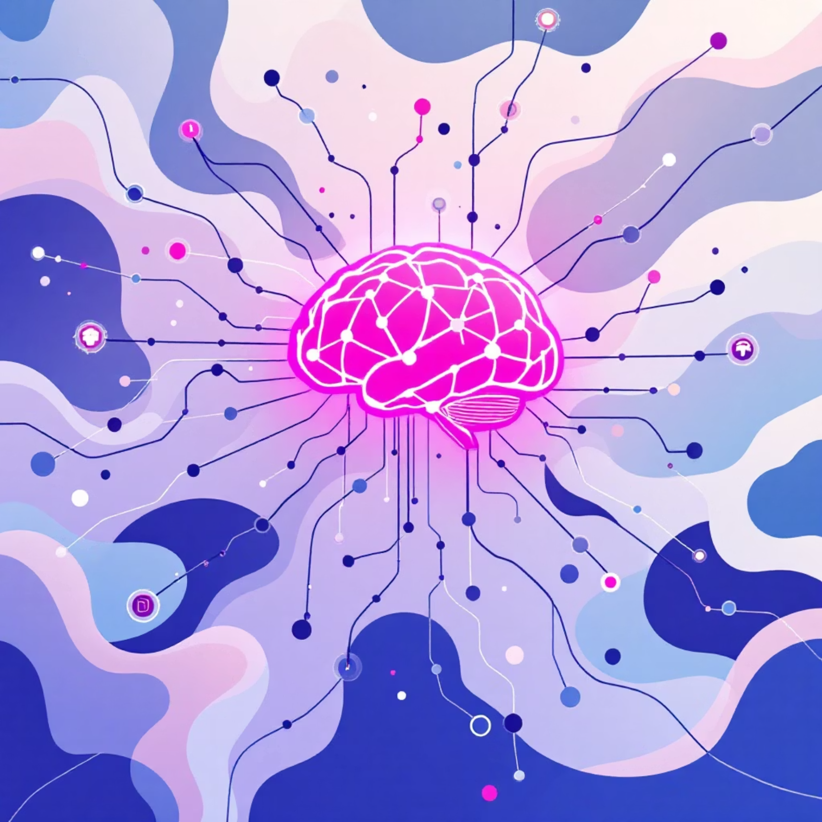
Conclusion: A New Era of Predictive Healthcare
This project successfully demonstrates a complete AI-driven pipeline for disease prediction, encompassing data preprocessing, model training, deployment, and user interaction.
The Random Forest model achieved exceptional accuracy on the dataset and was effectively deployed using Flask and Streamlit.
Our system delivers fast, reliable, and user-friendly predictions, proving its suitability for educational, research, and awareness initiatives.
With further enhancements and the integration of real-world medical data, this project holds immense potential to evolve into a comprehensive digital healthcare assistant, revolutionising early disease detection.

